Slide 1
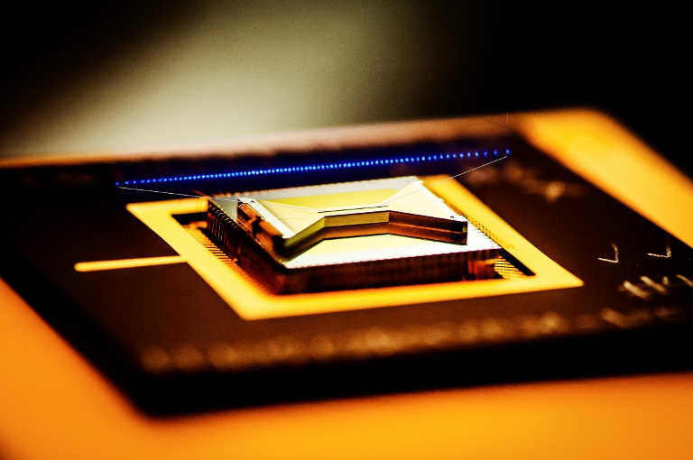

Thesis Proposal Cloud Quantum RNG for Cryptography Andrew Pham

Slide 2
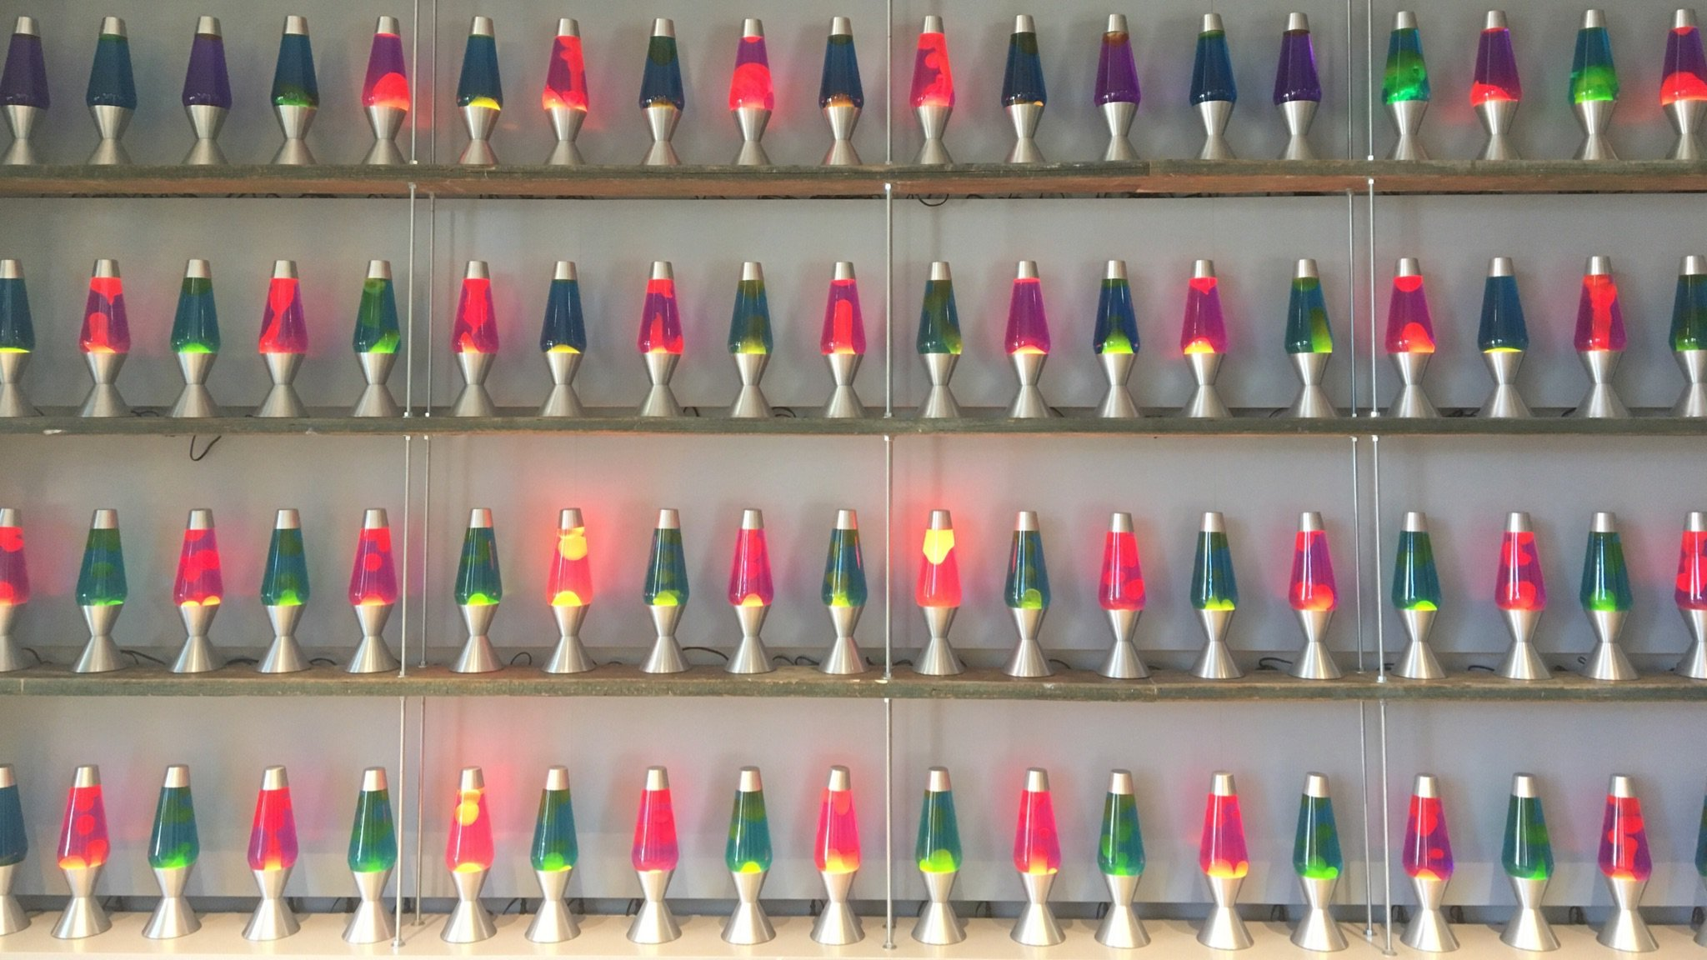
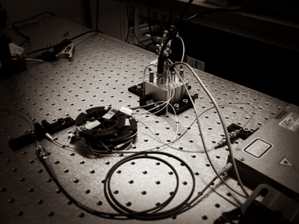

Background
Modern cryptographic security relies on RNG
Cryptographic keys must be random to be secure
PRNGs vs HRNGs
Current Quantum RNGs
Notes:
analogous to the combination of a safe
Cryptographic keys must be random to be secure because if the attacker has information on which keys are more or less likely, it makes guessing the key easier. computers make guesses very quickly
rngs typically used together
Historic attempts at HRNG like lava lamps. its said that 10% of all internet data is encrypted by these lava lamps
if you had a high resolution simulation of a coin toss, actually deterministic as all physical processes are. except...
Australian national university, fluctuations in em field in a vacuum
uses randomness extractor

Slide 3
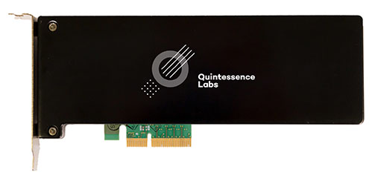
Aims
Create a “perfect” method of random number generation
Make quantum RNG available on demand to everyday consumers
Prove this method of cloud quantum RNG cryptographically secure
Notes:
physically unpredictable by our known laws of science
not everyone has a qrng built in, our solution….

Slide 4


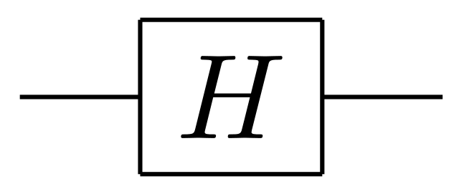

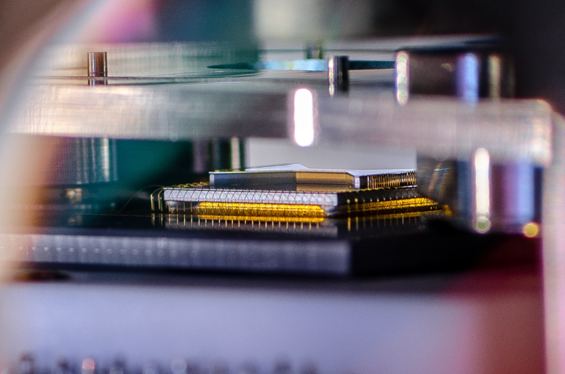
Proposed Methods
Equipment
Technique
Testing
Notes:
Quantum computer in the cloud
hadamard initialization, observing qubits
puts qubit into superposition, built in gate
observe qubit as 0 or 1
nist, us department of commerce, de facto cryptographic rng standards test

Slide 5
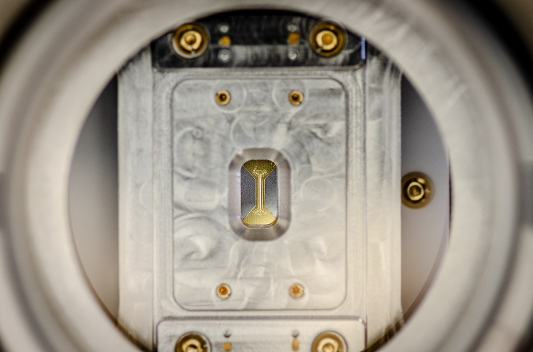
Timeline
Dev Environment Setup, 1 month
Codebase written and data generated, 1 month
Statistical testing, 1 month
Design of further experiments and testing, 2 months

Slide 6
Questions?

